Slide 1
Systems Analysis and Design 10th Edition
Chapter 5
Data and Process Modeling

Slide 2
Chapter Objectives
Describe data and process modeling concepts and tools, including data flow diagrams, a data dictionary, and process descriptions
Describe the symbols used in data flow diagrams and explain the rules for their use
Draw data flow diagrams in a sequence, from general to specific

Slide 3
Chapter Objectives (Cont.)
Explain how to level and balance a set of data flow diagrams
Describe how a data dictionary is used and what it contains
Use process description tools, including structured English, decision tables, and decision trees
Describe the relationship between logical and physical models

Slide 4
Overview of Data and Process Modeling Tools
Systems analysts use many graphical techniques to describe an information system
A data flow diagram (DFD) uses various symbols to show how the system transforms input data into useful information

Slide 5
Data Flow Diagrams
A data flow diagram (DFD) shows how data moves through an information system but does not show program logic or processing steps
A set of DFDs provides a logical model that shows what the system does, not how it does it

Slide 6
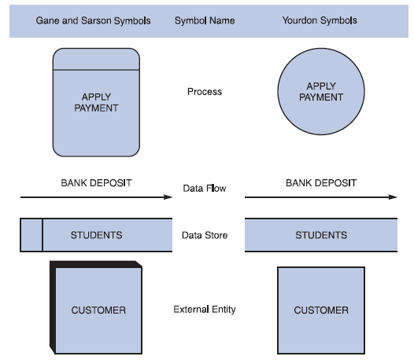
Data Flow Diagrams (Cont.)
DFD Symbols
Four basic symbols
Gane & Sarson used in text
Yourdon also popular
FIGURE 5-3 Data flow diagram symbols, symbol names, and examples of the Gane and Sarson and Yourdon symbol sets

Slide 7
Data Flow Diagrams (Cont.)
Process Symbol
Must have at least one input and at least one output
Contains business logic that transforms the data
Process name identifies its function (verb)
Process number does not signify precedence
Examples: “print bill” or “add customer”

Slide 8
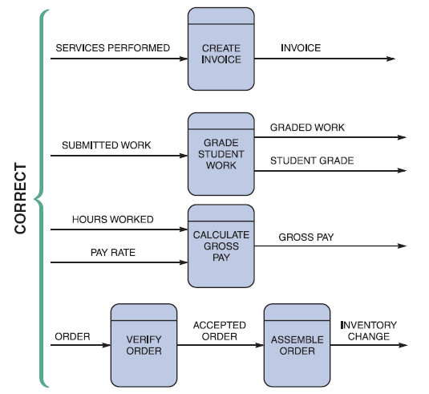
Data Flow Diagrams (Cont.)
Data flow symbol
Represents one or more data items
The symbol for a data flow is a line with a single or double arrowhead
FIGURE 5-5 Examples of correct combinations of data flow and process symbols

Slide 9
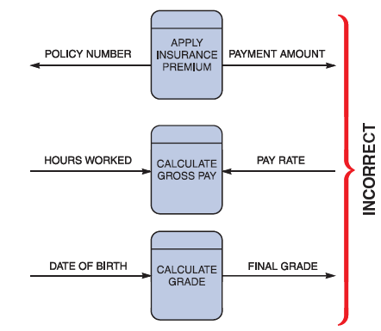
Data Flow Diagrams (Cont.)
Data flow symbol
Spontaneous generation (Process must act on input)
Black holes
Gray holes
FIGURE 5-6 Examples of incorrect combinations of data flow and process symbols. APPLY INSURANCE PREMIUM has no input and is called a spontaneous generation process. CALCULATE GROSS PAY has no outputs and is called a black hole process. CALCULATE GRADE has an input that is obviously unable to produce the output. This process is called a gray hole

Slide 10
Data Flow Diagrams (Cont.)
Data Store symbol
Represent data that the system stores
A DFD does not show the detailed contents of a data store — the specific structure and data elements are defined in the data dictionary
A data store must be connected to a process with a data flow

Slide 11
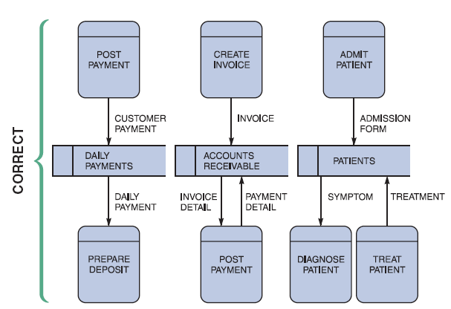
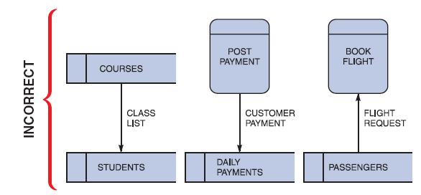
Data Flow Diagrams (Cont.)
FIGURE 5-8 Examples of incorrect uses of data store symbols: Two data stores cannot be connected by a data flow without an intervening process, and each data store should have an outgoing and incoming data flow
FIGURE 5-7 Examples of correct uses of data store symbols in a data flow diagram

Slide 12
Data Flow Diagrams (Cont.)
Shows how the system interfaces with the outside world
A DFD shows only external entities that provide data to the system or receive output from the system
DFD entities also are called terminators because they are data origins or final destinations
Each entity must be connected to a process by a data flow

Slide 13
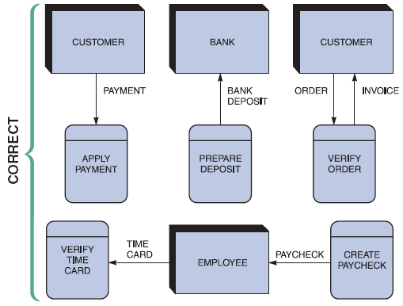
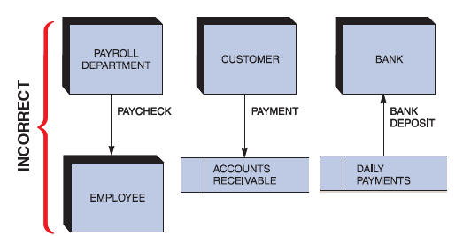
Data Flow Diagrams (Cont.)
FIGURE 5-10 Examples of incorrect uses of external entities. An external entity must be connected by a data flow to a process, and not directly to a data store or to another external entity
FIGURE 5-9 Examples of correct uses of external entities in a data flow diagram

Slide 14
Creating a Set of DFDs
Create a graphical model of the information system based on your fact-finding results
First, you will review a set of guidelines for drawing DFDs
Then you will learn how to apply these guidelines and create a set of DFDs using a three-step process

Slide 15
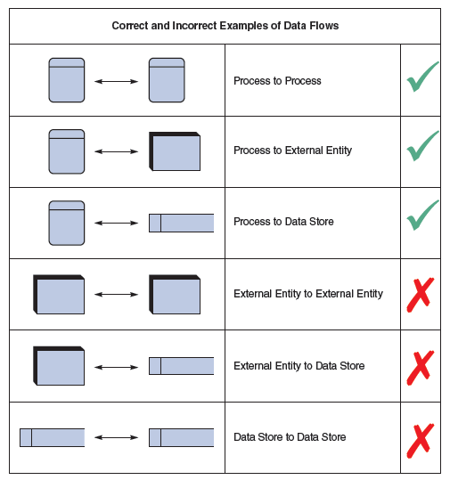
Creating a Set of DFDs (Cont.)
Keep in mind:
All flow lines must be labeled
Large processes can be broken down into smaller components
FIGURE 5-11 Examples of correct and incorrect uses of data flows

Slide 16
Creating a Set of DFDs (Cont.)
Guidelines for Drawing DFDs
Draw the context diagram so that it fits on one page
Use the name of the information system as the process name in the context diagram
Use unique names within each set of symbols
Do not cross lines
Provide a unique name and reference number for each process
Ensure that the model is accurate, easy to understand, and meets the needs of its users

Slide 17
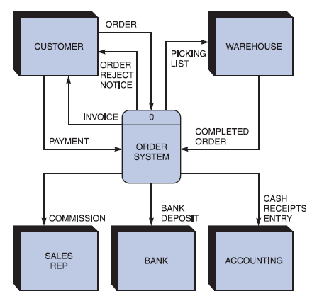
Creating a Set of DFDs (Cont.)
Step 1: Draw a Context Diagram
FIGURE 5-13 Context diagram DFD for an order system

Slide 18
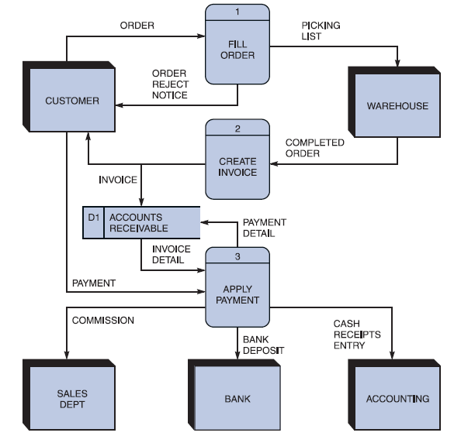
Creating a Set of DFDs (Cont.)
Step 2: Draw a Diagram 0 DFD
If same data flows in both directions, you can use a double-headed arrow
Diagram 0 is an exploded view of process 0
Parent diagram
Child diagram
Functional primitive
FIGURE 5-16 Diagram 0 DFD for the order system

Slide 19
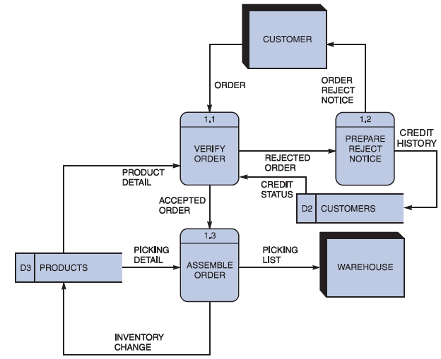
Creating a Set of DFDs (Cont.)
Step 3: Draw the Lower Level Diagrams
FIGURE 5-17 Diagram 1 DFD shows details of the FILLORDER process in the order system

Slide 20
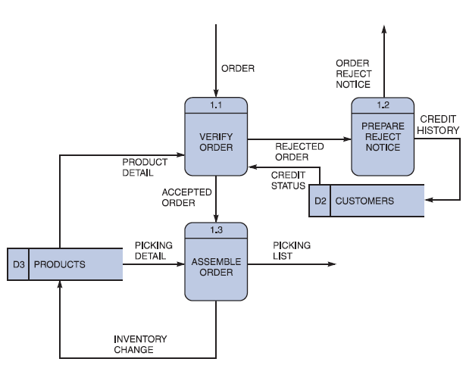
Creating a Set of DFDs (Cont.)
Must use leveling and balancing techniques
Leveling examples
Uses a series of increasingly detailed DFDs to describe an information system
Exploding, partitioning, or decomposing
FIGURE 5-18 This diagram does not show the symbols that connect to data flows entering or leaving FILL ORDER on the context diagram

Slide 21
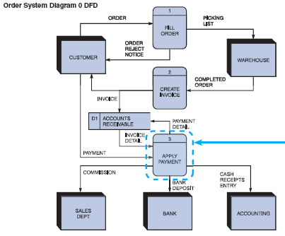
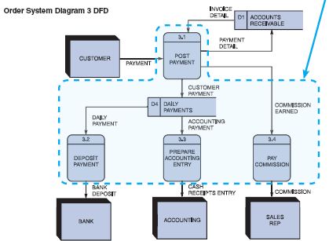
Creating a Set of DFDs (Cont.)
FIGURE 5-19 The order system diagram 0 is shown at the top of the figure, and exploded diagram 3 DFD (for the APPLY PAYMENT process) is shown at the bottom. The two DFDs are balanced because the child diagram at the bottom has the same input and output flows as the parent process 3 shown at the top

Slide 22
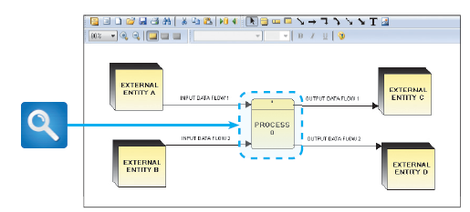
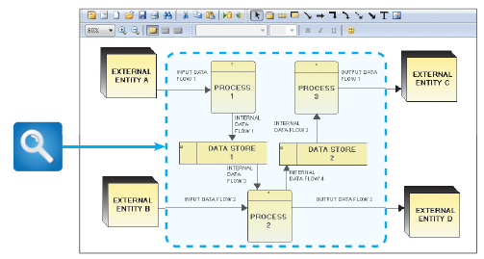
Creating a Set of DFDs (Cont.)
FIGURE 5-20 Example of a parent DFD diagram, showing process 0 as a black box
FIGURE 5-21 In the next level of detail, the process 0 black box reveals three processes, two data stores, and four internal data flows — all of which are shown inside the dashed line

Slide 23
Data Dictionary
A data dictionary, or data repository, is a central storehouse of information about the system’s data
An analyst uses the data dictionary to collect, document, and organize specific facts about the system
Also defines and describes all data elements and meaningful combinations of data elements

Slide 24
Data Dictionary (Cont.)
A data element, also called a data item or field, is the smallest piece of data that has meaning
Data elements are combined into records, also called data structures
A record is a meaningful combination of related data elements that is included in a data flow or retained in a data store

Slide 25
Data Dictionary (Cont.)
Using CASE Tools for Documentation
The more complex the system, the more difficult it is to maintain full and accurate documentation
Modern CASE tools simplify the task
A CASE repository ensures data consistency
The CASE tools in Part B of the Systems Analyst’s Toolkit can help you document business functions and processes
To learn more about these tools, turn to Part B of the four-part Toolkit that follows Chapter 12

Slide 26
Data Dictionary (Cont.)
Documenting the Data Elements
You must document every data element in the data dictionary
The objective is the same: to provide clear, comprehensive information about the data and processes that make up the system

Slide 27
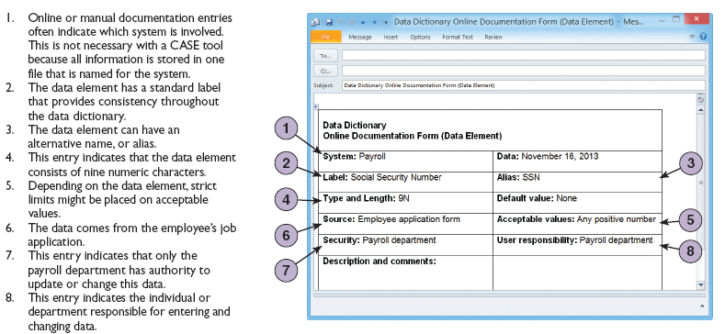
Data Dictionary (Cont.)
FIGURE 5-23 Using an online documentation form, the analyst has recorded information for a data element named SOCIAL SECURITY NUMBER. Later, the analyst will create a data dictionary entry using a CASE tool

Slide 28
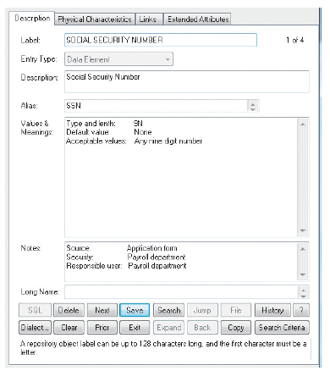
Data Dictionary (Cont.)
Documenting the Data Elements
Data element name and label
Alias
Type and length
Default value
Acceptable values - Domain and validity rules
Source
Security
Responsible user(s)
Description and comments
FIGURE 5-24 A Visible Analyst screen describes the data element named SOCIAL SECURITY NUMBER. Notice that many of the items were entered from the online form shown in Figure 5-23

Slide 29
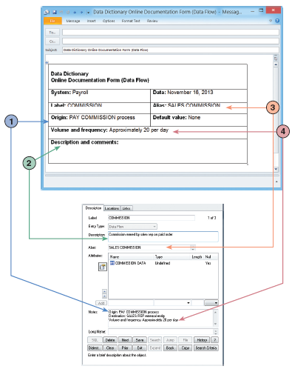
Data Dictionary (Cont.)
Documenting the Data Flows
Data flow name or label
Description
Alternate name(s)
Origin
Destination
Record
Volume and frequency
FIGURE 5-25 In the upper screen, an analyst has entered four items of information in an online documentation form. The lower screen shows the same four items entered into a Visible Analyst data dictionary form

Slide 30
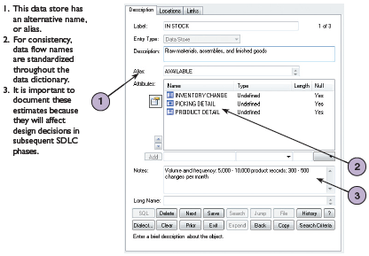
Data Dictionary (Cont.)
Documenting the Data Stores
Data store name or label
Description
Alternate name(s)
Attributes
Volume and frequency
FIGURE 5-26 Visible Analyst screen that documents a
data store named IN STOCK

Slide 31
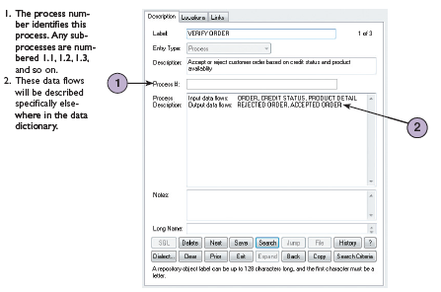
Data Dictionary (Cont.)
Documenting the Processes
Process name or label
Description
Process number
Process description
FIGURE 5-27 Visible Analyst screen that describes a
process named VERIFY ORDER

Slide 32
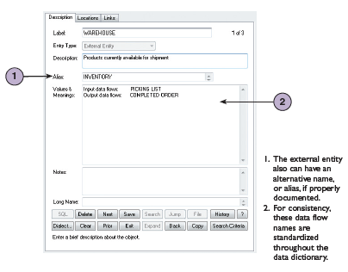
Data Dictionary (Cont.)
Documenting the Entities
Entity name
Description
Alternate name(s)
Input data flows
Output data flows
FIGURE 5-28 Visible Analyst screen that documents
an external entity named WAREHOUSE

Slide 33
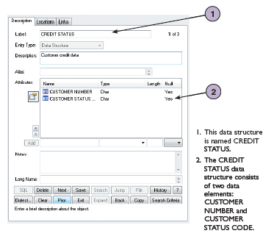
Data Dictionary (Cont.)
Documenting the Records
Record or data structure name
Definition or description
Alternate name(s)
Attributes
FIGURE 5-29 Visible Analyst screen that documents a
record, or data structure named CREDIT STATUS

Slide 34
Data Dictionary (Cont.)
Data Dictionary Reports
Many valuable reports
An alphabetized list of all data elements by name
A report describing each data element and indicating the user or department that is responsible for data entry, updating, or deletion
A report of all data flows and data stores that use a particular data element
Detailed reports showing all characteristics of data elements, records, data flows, processes, or any other selected item stored in the data

Slide 35
Process Description Tools
Typical process description tools include structured English, decision tables, and decision trees
Process description tools also can be used in object-oriented development
O-O programmers use different terminology. They create the same kind of modular coding structures, except that the processes, or methods, are stored inside the objects, rather than as separate components

Slide 36

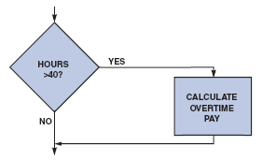
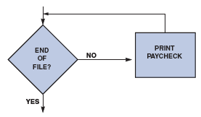
Process Description Tools (Cont.)
Modular Design
Based on combinations of three logical structures, sometimes called control structures, which serve as building blocks for the process
Sequence
Selection
Iteration - looping
FIGURE 5-30 Sequence structure
FIGURE 5-31 Selection structure
FIGURE 5-32 Iteration structure

Slide 37
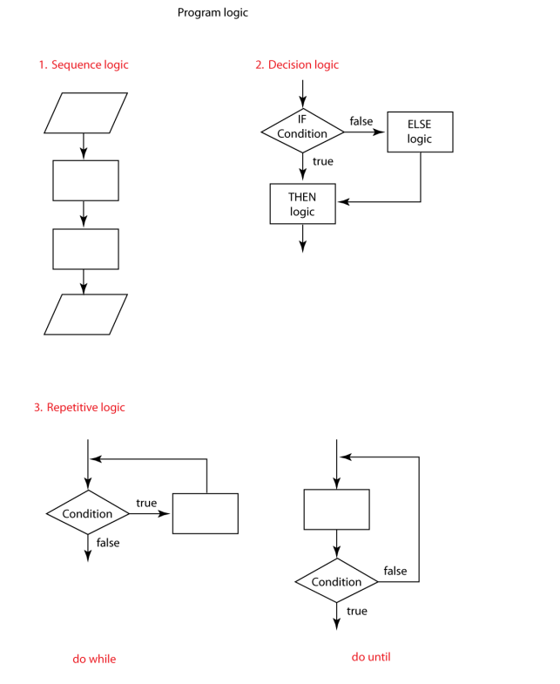

Slide 38
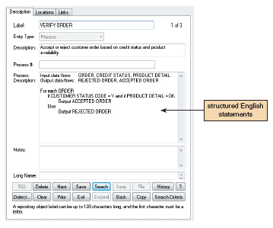
Process Description Tools (Cont.)
Structured English
Must conform to the following rules
Use only the three building blocks of sequence, selection, and iteration
Use indentation for readability
Use a limited vocabulary, including standard terms used in the data dictionary and specific words that describe the processing rules
FIGURE 5-33 The VERIFY ORDER process description
includes logical rules and a structured English version of
the policy. Notice the alignment and indentation of the
logic statements

Slide 39
Process Description Tools (Cont.)
Decision Tables
Shows a logical structure, with all possible combinations of conditions and resulting actions
It is important to consider every possible outcome to ensure that you have overlooked nothing
The number of rules doubles each time you add a condition
Can have more than two possible outcomes
Often are the best way to describe a complex set of conditions

Slide 40
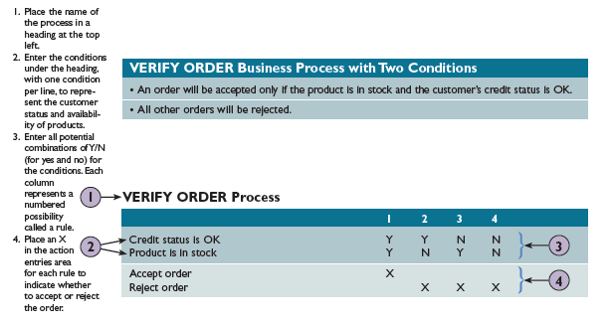
Process Description Tools (Cont.)
FIGURE 5-34 The Verify Order business process has two conditions. For an order to be accepted, the product must be in stock and the customer must have an acceptable credit status
FIGURE 5-35 Example of a simple decision table showing the processing logic of the VERIFY ORDER process

Slide 41
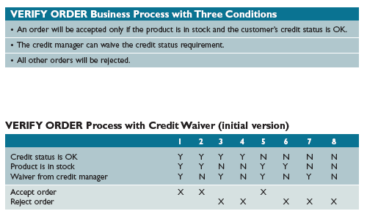
Process Description Tools (Cont.)
FIGURE 5-36 A third condition has been added to the Verify Order business process. For an order to be accepted, the product must be in stock and the customer must have an acceptable credit status. However, the credit manager now has the authority to waive the credit status requirement
FIGURE 5-37 This table is based on the Verify Order conditions shown in Figure 5-36. With three conditions, there are eight possible combinations, or rules

Slide 42
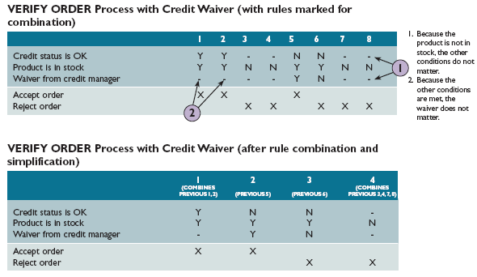
Process Description Tools (Cont.)
FIGURE 5-38 In the first table, dashes have been added to indicate that a condition is not relevant. In the second version, rules have been combined. Notice that in final version, only four rules remain. These rules document the logic, and will be transformed into program code when the system is developed

Slide 43
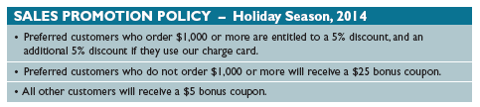
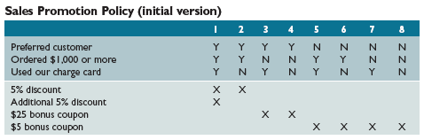
Process Description Tools (Cont.)
FIGURE 5-39 A sales promotion policy with three conditions. Notice that the first statement contains two separate conditions – one for the 5% discount, and another for the additional discount
FIGURE 5-40 This decision table is based on the sales promotion policy in Figure 5-39. This is the initial version of the table, before simplification

Slide 44
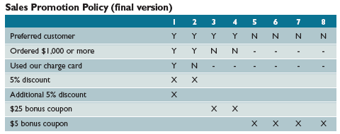
Process Description Tools (Cont.)
FIGURE 5-41 In this version, dashes have been added to indicate that a condition is not relevant. At this point, it appears that several rules can be combined

Slide 45
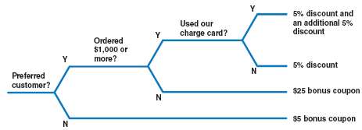
Process Description Tools (Cont.)
Decision Trees
Graphical representation of the conditions, actions, and rules found in a decision table
Show the logic structure in a horizontal form that resembles a tree with the roots at the left and the branches to the right
Decision trees and decision tables provide the same results, but in different forms
FIGURE 5-42 This example is based on the same Sales Promotion Policy shown in the decision tables in Figures 5-40 and 5-41 on the previous page. Like a decision table, a decision tree shows all combinations of conditions and outcomes. The main difference is the graphical format, which many viewers find easier to interpret

Slide 46
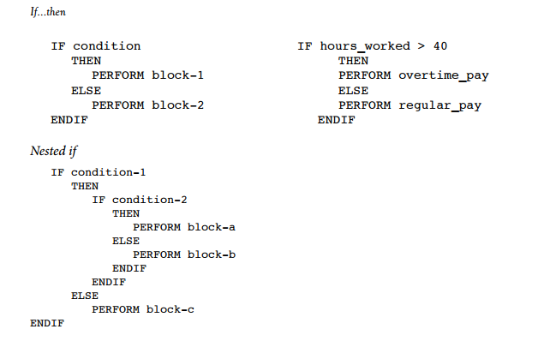
Pseudocode

Slide 47


Pseudocode

Slide 48
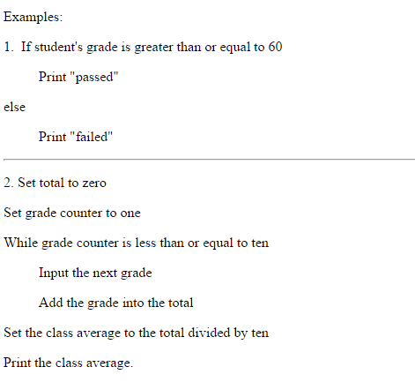
Pseudocode

Slide 49
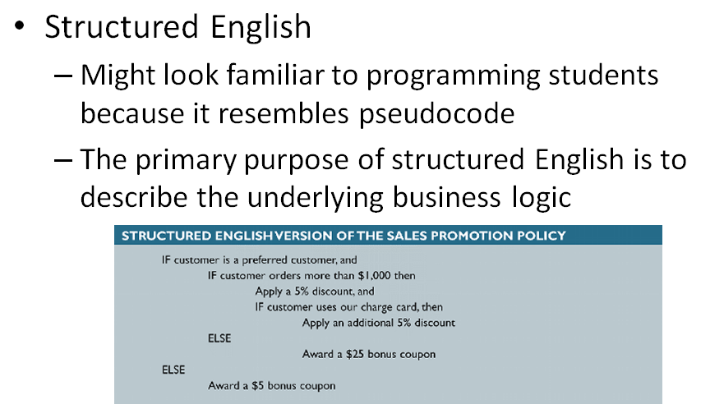
Pseudocode

Slide 50
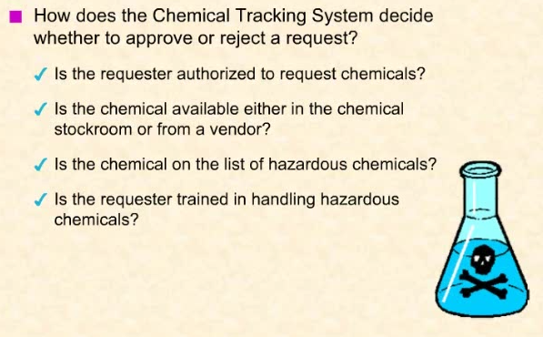
Decision Table & Decision Tree

Slide 51
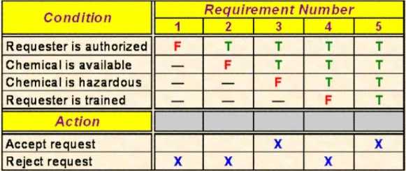
A Sample Decision Table

Slide 52
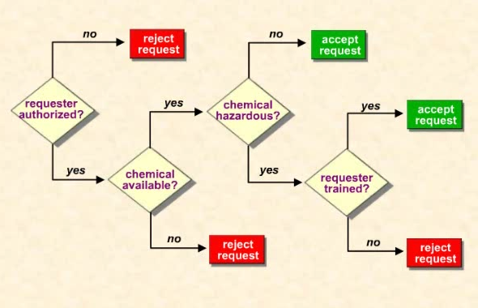
A Sample Decision Tree

Slide 53
Logical versus Physical Models
While structured analysis tools are used to develop a logical model for a new information system, such tools also can be used to develop physical models of an information system
A physical model shows how the system’s requirements are implemented

Slide 54
Logical versus Physical Models (Cont.)
Sequence of Models
Many systems analysts create a physical model of the current system and then develop a logical model of the current system before tackling a logical model of the new system
Performing that extra step allows them to understand the current system better

Slide 55
Logical versus Physical Models (Cont.)
Four-Model Approach
Develop
A physical model of the current system
A logical model of the current system
A logical model of the new system
A physical model of the new system
The only disadvantage of the four-model approach is the added time and cost

Slide 56
Chapter Summary
During data and process modeling, a systems analyst develops graphical models to show how the system transforms data into useful information
The end product of data and process modeling is a logical model that will support business operations and meet user needs
Data and process modeling involves three main tools: data flow diagrams, a data dictionary, and process descriptions

Slide 57
Chapter Summary (Cont.)
Data flow diagrams (DFDs) graphically show the movement and transformation of data in the information system
DFDs use four symbols
A set of DFDs is like a pyramid with the context diagram at the top
The data dictionary is the central documentation tool for structured analysis

Slide 58
Chapter Summary (Cont.)
Each functional primitive process is documented using structured English, decision tables, and decision trees
Structured analysis tools can be used to develop a logical model during one systems analysis phase, and a physical model during the systems design phase

